Slide 1

CodeU Class 4 Welcome!
The class will start shortly
Reproduction and distribution of the presentation deck is prohibited

Slide 2
Agenda for today’s class
Recap of last class
01
02
Homework correction
To refresh our minds!
We’ll revise the hw to understand better
Topics of the day:
03
04
Practice time!
Learn how to code like a pro!
- Lists
- Loops: WHILE
Wrap-up
Conclusion
05
06
CodeU Robot
Summary of what we’ve learned today
homework and questions

Slide 3
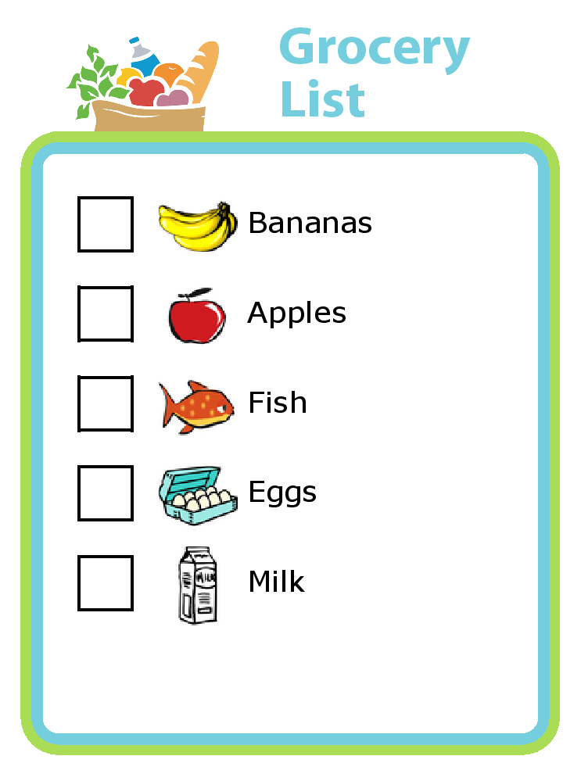
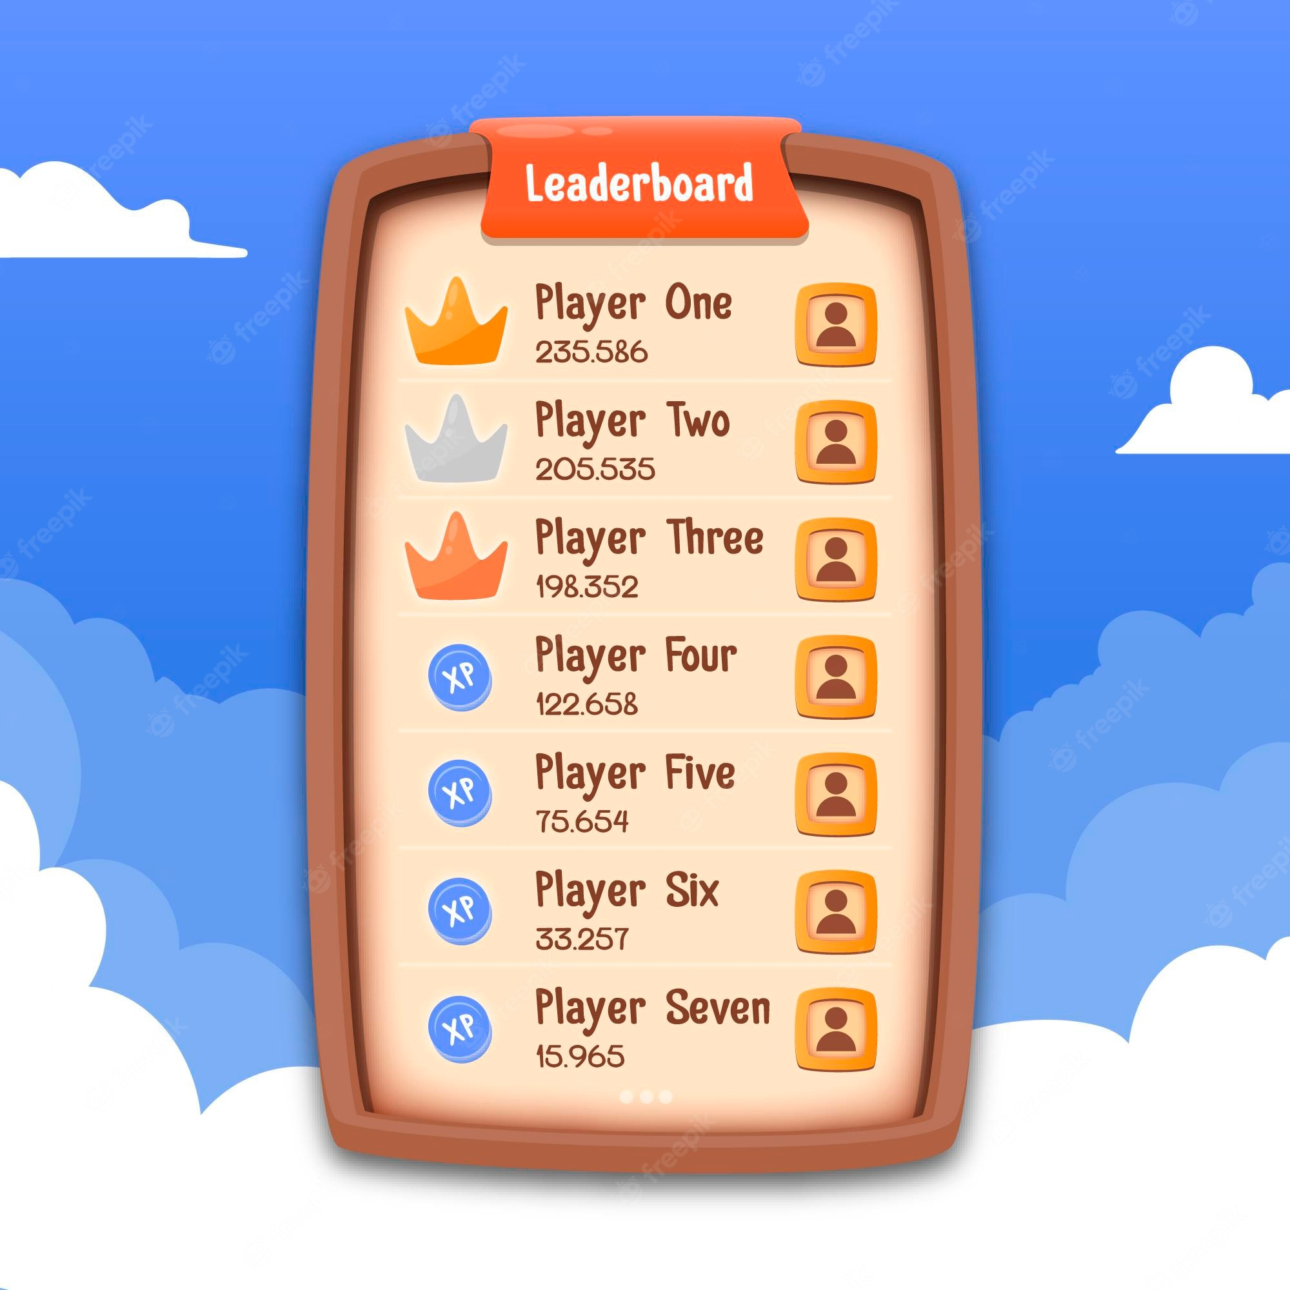

Introduction to LISTS!
01
What are lists?
A list is a number of items in an ordered or unordered structure. A list can be used for a number of things like storing items or deleting and adding items.
Example in a code:
groceryList = [”apples”, “milk”, “cucumbers”, ”cereal”, ”eggs”]
There are lists in our everyday lives. Can you think of one?

Slide 4
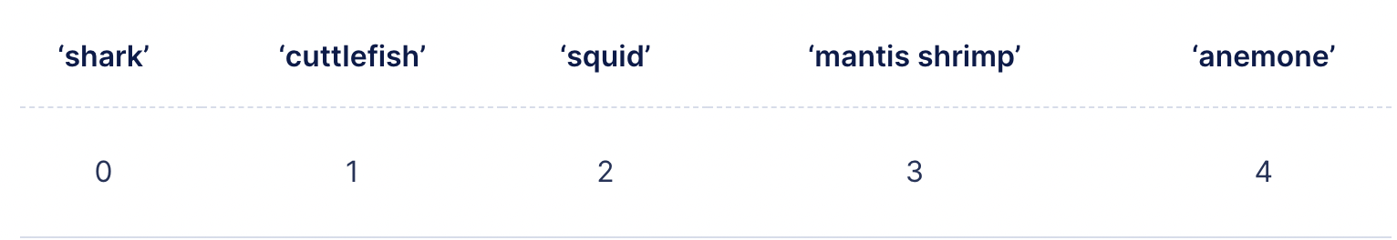
Introduction to LISTS! (cont’)
02
List Manipulation
Lists can be manipulated in many ways. This will allow us to edit the information contained in the list so we can achieve our wanted end result.
Example: In a grocery list, once we found an item, we can remove it.
Indexing Lists
Elements in a list are all in different positions. These positions are called indexes.
“shark” is at index 0 in the list
List example: animals = [“shark”, ”cuttlefish”, ”squid”, ”mantis shrimp”, ”anemone”]
animals[0] -> “shark”
animals[2] -> “squid”

Slide 5
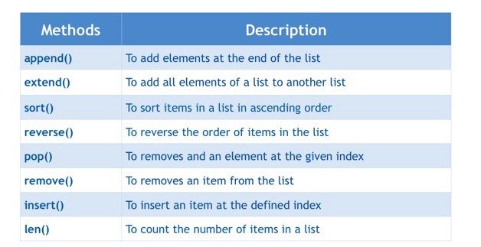
List methods
03

Slide 6
Introduction to While Loops
What is a LOOP?
A loop is a sequence of instructions that is continually repeated until a certain condition is reached.
Example
You ask your mom to buy chips. She says no. You keep asking until she says yes. Once she says yes, you stop asking. The condition here is that she says yes!
Syntax for While loops
while mom == “No”:
print(“Can we please buy some chips”)
**In this scenario, once the mom’s answer is “Yes”, the loop stops. If the mom keeps answering “No”, the loop will continue and the print() statement will be repeated.

Slide 7
Let’s practice!
Example 2
i = 10
while i>1:
print("Hello World")
i = i - 1
01
02
03
Example 1
i = 0
while i<5:
print(i)
i = i + 1
Example 3
answer = input("Can we got to the movies? ")
while answer == "no":
answer = input("Can we got to . the movies? ") print("Yay, thank you!")
04
Let’s build a countdown for a Track Race!
print(“Welcome to the annual CodeU Track Race”)
time.sleep(3)
timer = 3
while timer > 0:
print(timer)
timer -= 1
time.sleep(1) print("Go Go Go!")

Slide 8
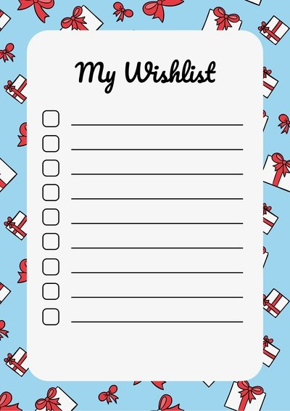
Homework: Create a Wish List!
Homework Description
For this week’s homework, you will build a Wish List Maker for anyone that would like to make a list of presents they would love to receive in the future!
1
You must create an empty list where each gift will be added
4
Create a WHILE Loop that ends once the list LENGTH is equal to 5.
2
You must define a variable using INPUT(). This is where the user is asked what present they would like to add to the list.
5
Print() the completed list to the user
3
The list can contain only 5 items.

Slide 9
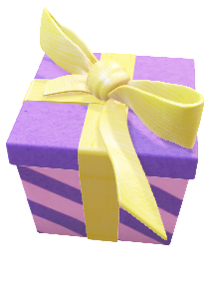
Homework Solution: Create a Wish List!
1
1st Part : Create an empty list
wishlist = []
2nd Part : Create the WHILE Loop that ends once the list LENGTH is 5
while len(wishlist) != 5:
gift = input("What gift would you like to add . to your Wish List?: ")
wishlist.append(gift)
3rd Part : Print() the list
print("Here is your Wish List!")
print(wishlist)

Slide 10



Thank you!
Does anyone have any questions?
Next class: class 5!
Phone:
(438) 391-9106
Please contact us to make any change in the schedule for the next class.
Email:
siva.sri14@hotmail.com
hello@codeu.ca
Website:
https://www.codeu.ca/
Reproduction and distribution of the presentation deck is prohibited

